Slide 1


CAPSTONE PROJECT
Elevating the Dining Experience
Presented By
Student Name: Bappi Raman singh
College Name:thakur college of science and commerce
Department: Information technology
Email ID:Bappi.r.singh@gmail.com

Slide 2
OUTLINE:
Problem Statement
Proposed System/Solution
System Development Approach (Technology Used)
Algorithm & Deployment
Result (Output Image)
Conclusion
Future Scope
References

Slide 3
Problem Statement:
Restaurants generate enormous amounts of sales data, but they often find it difficult to identify key trends, winners, and peak ordering times. Without the aid of visual analytics, it becomes difficult to leverage the data to inform business decisions to improve sales.

Slide 4
Proposed Solution:
One possible method to accomplish this would be to develop an interactive Power BI dashboard that explores historical sales data for restaurants. This will give a clear and visualized understanding of where money is being made, what types of food are most popular, and what methods are preferred for payment.

Slide 5
System Approach:
Tool: Microsoft Power BI Desktop
Data Source: CSV Sales Dataset
Techniques: Data Cleaning, Data Transformation (Power Query),
and Data Visualization (DAX & Interactive Charting).

Slide 6
Algorithm & Deployment:
Step 1: We acquired raw CSV data, which included over 4,000 orders from various restaurants.
Step 2: We prepared the data by correcting data types (Decimals, Dates) and filtering out cancelled orders.
Step 3: We designed interactive charts (Line, Donut, and Pie charts) to present the gross sales and estimated profits.
Step 4: We implemented interactivity using slicers to enable dynamic filtering by food category and a final static report for analysis.

Slide 7
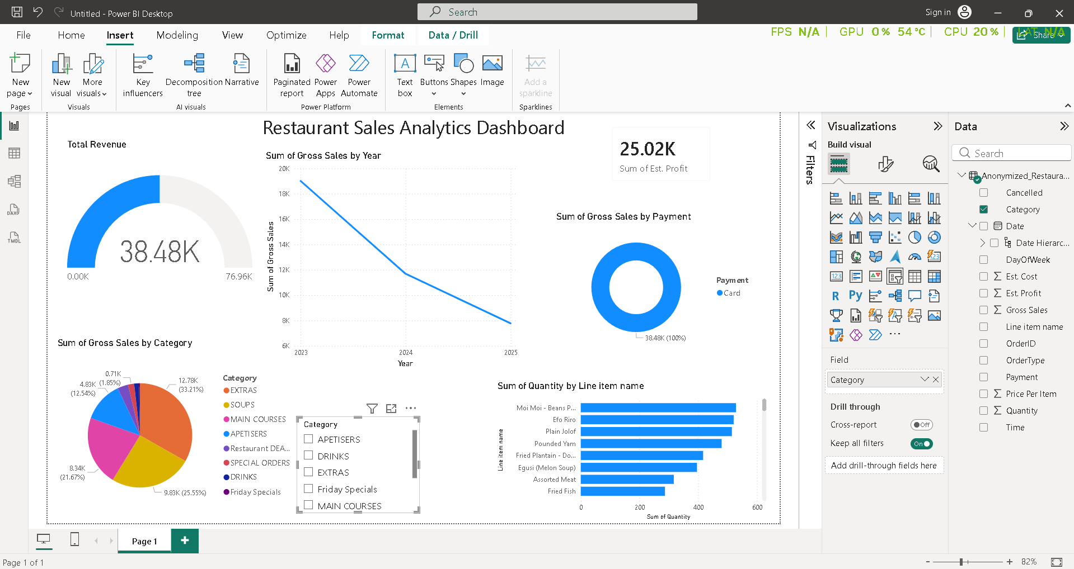
Result:

Slide 8
Conclusion:
The Power BI dashboard does a great job of converting the raw restaurant data into useful insights. From the data, it’s clear that the most preferred method of payment for the customers is cards, and the revenue for the restaurant comes from the sale of the main courses.

Slide 9
Future scope:
The future enhancements may include connecting this dashboard to a live database such as MySQL to monitor the sales in real-time. Further, the use of machine learning algorithms could be helpful to predict the sales for the next day or the peak hours based on the trends.

Slide 10
References:
GitHub Link: https://github.com/SinghBappi/Edunet_MS_Power_Bi_Internship
LinkedIn Post Link:https://www.linkedin.com/posts/bappi-singh-13a15a33b_powerbi-dataanalytics-microsoftlearn-activity-7438603519768670208-qE3u?utm_source=share&utm_medium=member_desktop&rcm=ACoAAFVGFT4Bv4f_Rebye2FBbgS7mURboFtvBcA
Google Drive Link(Actual File): https://drive.google.com/file/d/1lhTUR2TkuU89VoRTJrvKH2qwVDD5CIeV/view?usp=sharing
Output Link: https://drive.google.com/file/d/1ASyJyuwt64qZqI1-OkOse2l7tzoRNtfy/view?usp=sharing
Video Demostration Link: https://drive.google.com/file/d/1iBNYuX0txAh9fcKNK1G5o78AvD_H1JLx/view?usp=sharing

Slide 11
Thank You

